Slide 1
Graphs
Computer Science, Purdue University
Copyright Wiley, Goodrich and Tamassia

Slide 2
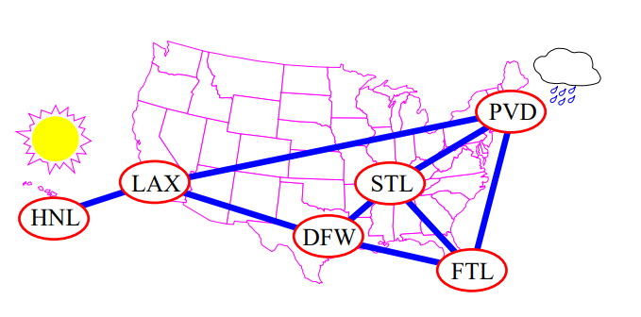
Graphs
Introduction
Basic Definitions
The Graph Abstract Data Type
Data Structures for Storing Graphs
Computer Science, Purdue University

Slide 3
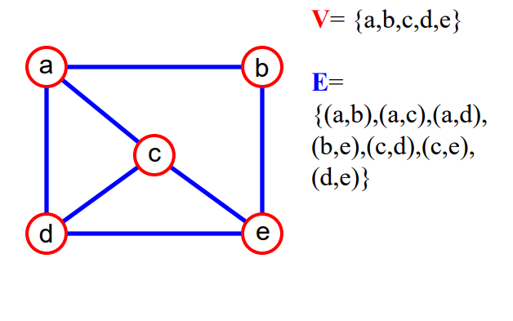
Graphs
Basic Defitions
A graph G = (V,E) is composed of: V: set of vertices E: set of edges connecting the vertices in V
An edge e = (u,v) is a pair of vertices
Example:
Computer Science, Purdue University

Slide 4
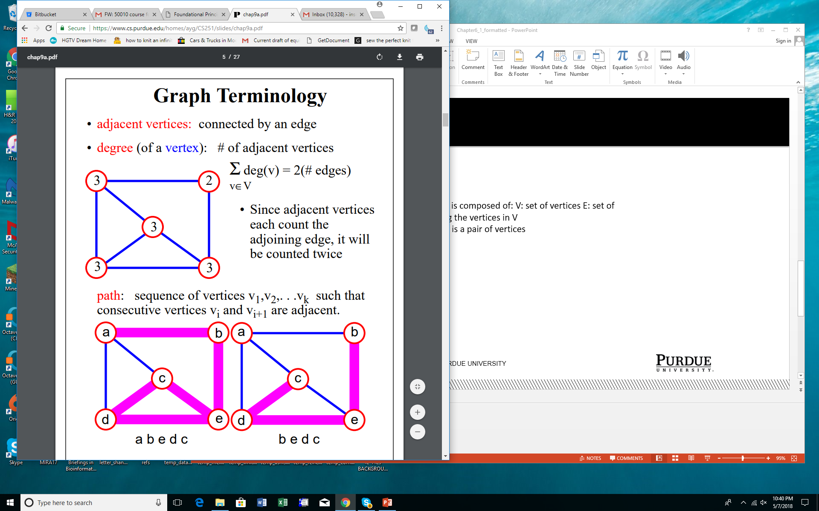
Graphs
Basic Defitions
Computer Science, Purdue University

Slide 5
Graphs
Basic Defitions
e
Computer Science, Purdue University

Slide 6
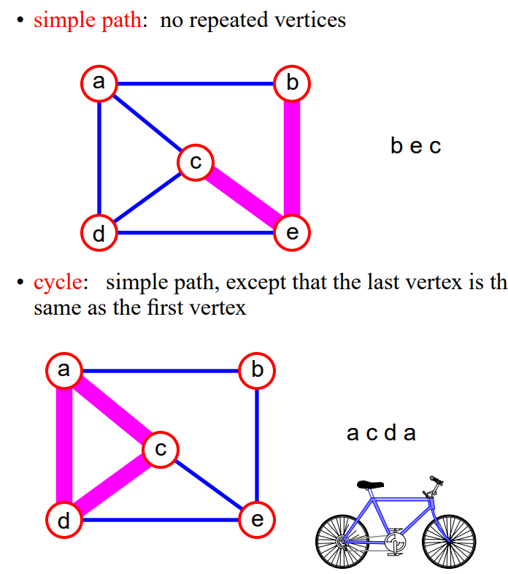
Graphs
Basic Defitions
Computer Science, Purdue University

Slide 7
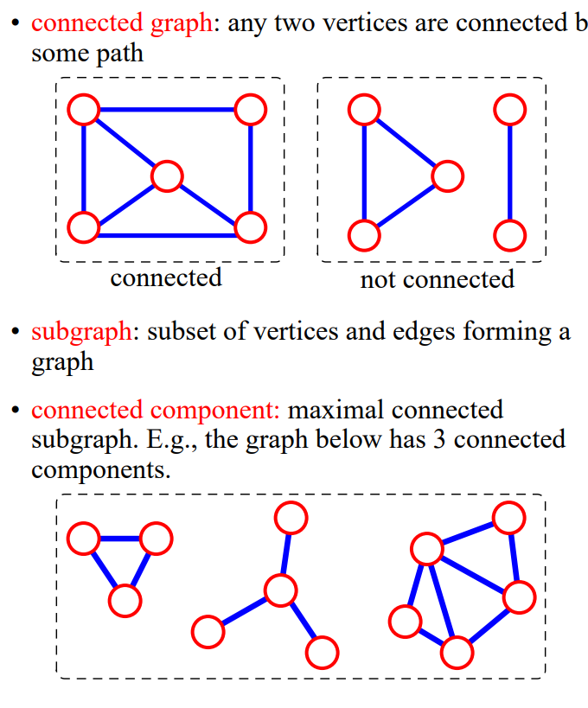
Graphs
Basic Defitions
Computer Science, Purdue University

Slide 8
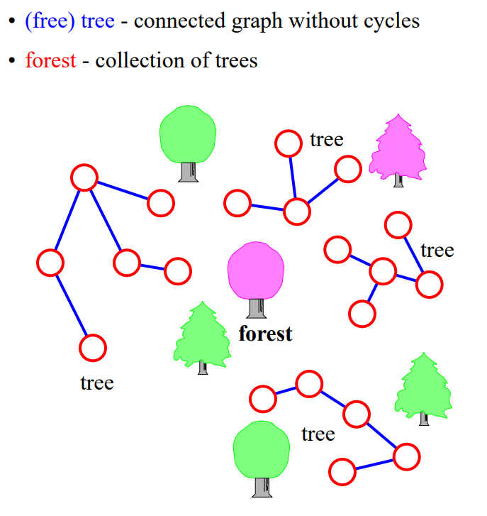
Graphs
Basic Defitions
Computer Science, Purdue University

Slide 9
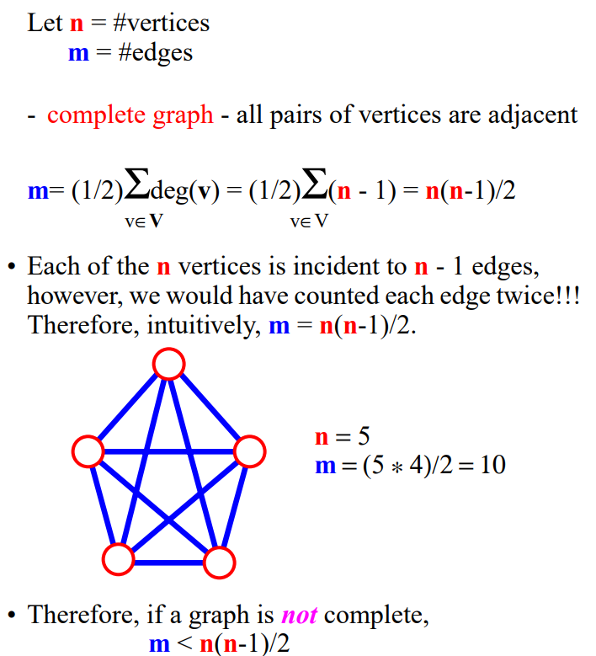
Graphs
Connectivity
Computer Science, Purdue University

Slide 10
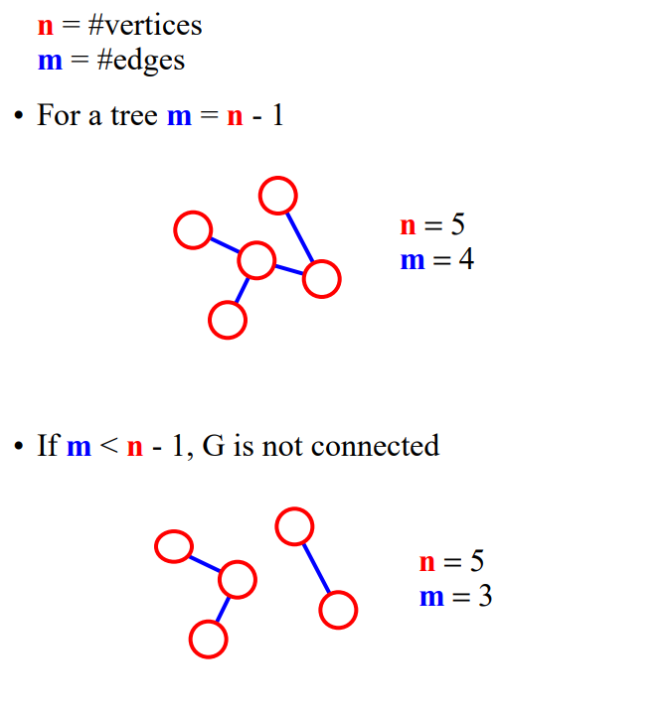
Graphs
Connectivity
Computer Science, Purdue University

Slide 11
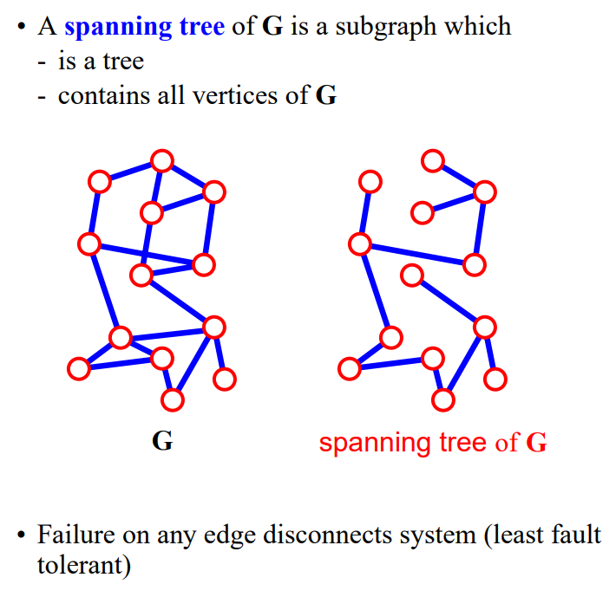
Graphs
Spanning Tree
Computer Science, Purdue University

Slide 12
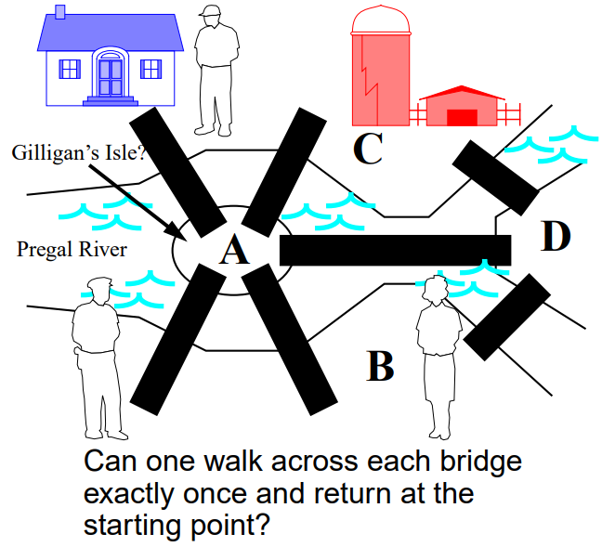
Graphs
Euler and Bridges of Koeningsberg
Computer Science, Purdue University

Slide 13
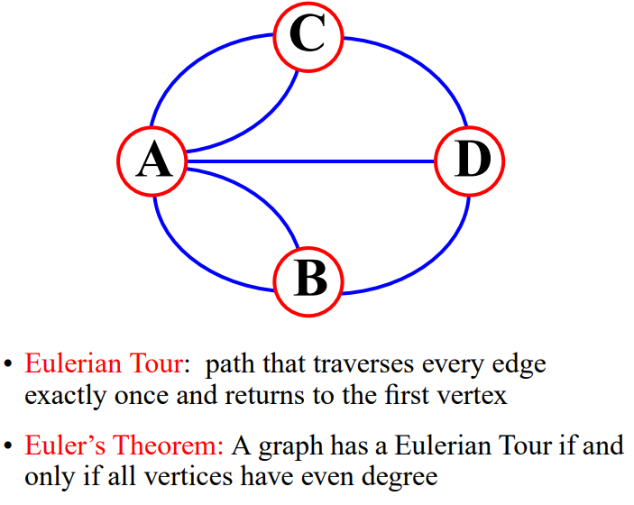
Graphs
Bridges of Koeningsberg
Computer Science, Purdue University

Slide 14
Thank You

